Slide 1
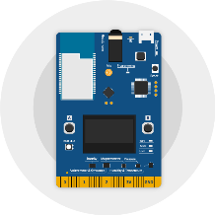

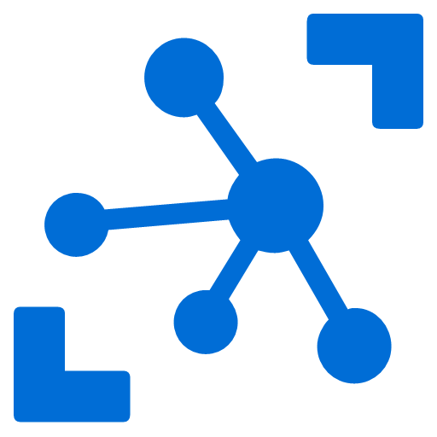
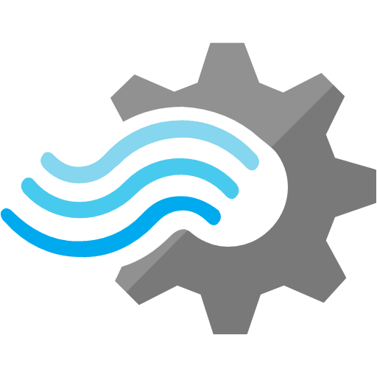
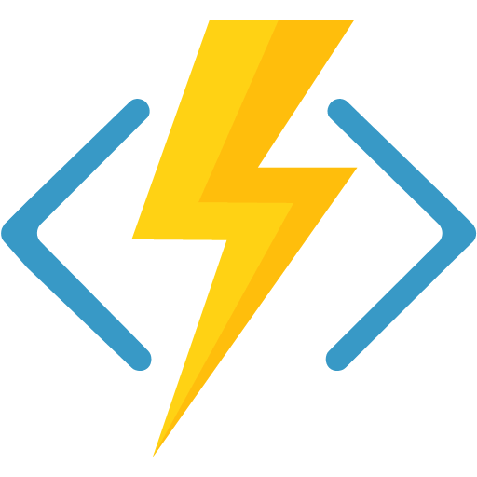
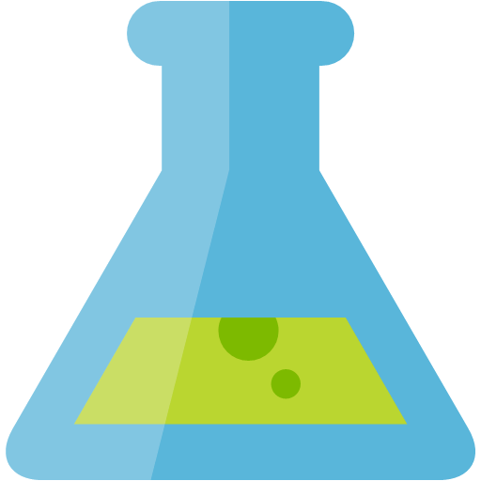
Common scenarios IoT / Big Data Lambda Architecture
Batch Processing
Azure IoT Hub
Stream Analytics
IoT Devices
Real-Time Processing and Analytics
Notes:
The Lambda Architecture design pattern, as used in both Internet of Things and Big Data solutions, enables these solutions to handle massive quantities of data by taking advantage of both Batch processing and Real-Time Stream processing methods within the same solution.
LINKS:
https://en.wikipedia.org/wiki/Lambda_architecture
Azure IoT DevKit image from https://microsoft.github.io/azure-iot-developer-kit/

Slide 2

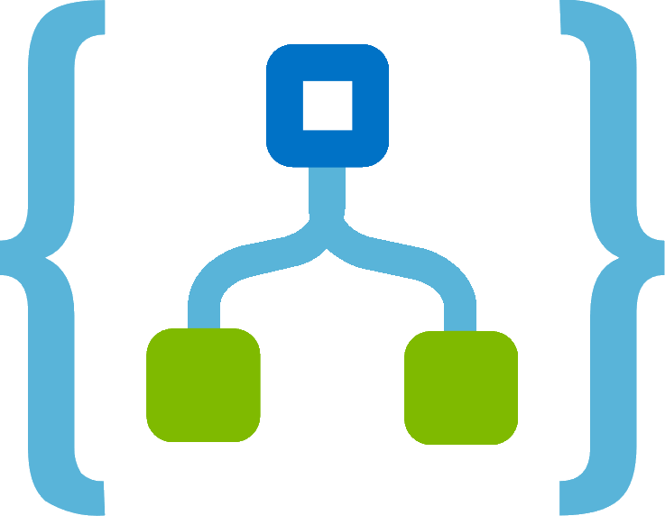
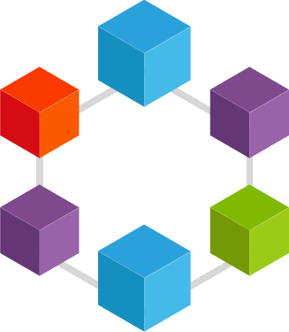
Preferred solution – IoT Device Integration
Azure IoT Hub
Stream Analytics
Service Bus Queue
Logic Apps
Azure Blockchain Workbench
(using Ethereum)
IoT Devices
Notes:
A device communicates directly or via a field gateway to IoT Hub.
Azure Stream Analytics receives the device messages from IoT Hub, and evaluates the messages.
Azure Stream Analytics then sends the messages to Azure Service Bus.
A Logic App or other custom code retrieves and transforms the message to a known format.
The transformed message, now in a standard format, is sent to the Azure Service Bus for Azure Blockchain Workbench.
Azure Blockchain Workbench is subscribed to events from the Service Bus, and retrieves the message.
Azure Blockchain Workbench initiates a call to the ledger, sending data from the external system to a specific contract.
Upon receipt of the message, the contract evaluates the data and may change the state based on the outcome of the evaluation, for example, for a high temperature, change the state to ‘Out of Compliance’.
Workflow diagram showing IoT Device Integration starting with event data from the IoT Devices, flowing through Azure IoT Hub, then to Stream Analytics, then to Azure Service Bus Queue, triggering Logic Apps, then finally passing into the Azure Blockchain Workbench (using Ethereum)

